Slide 1

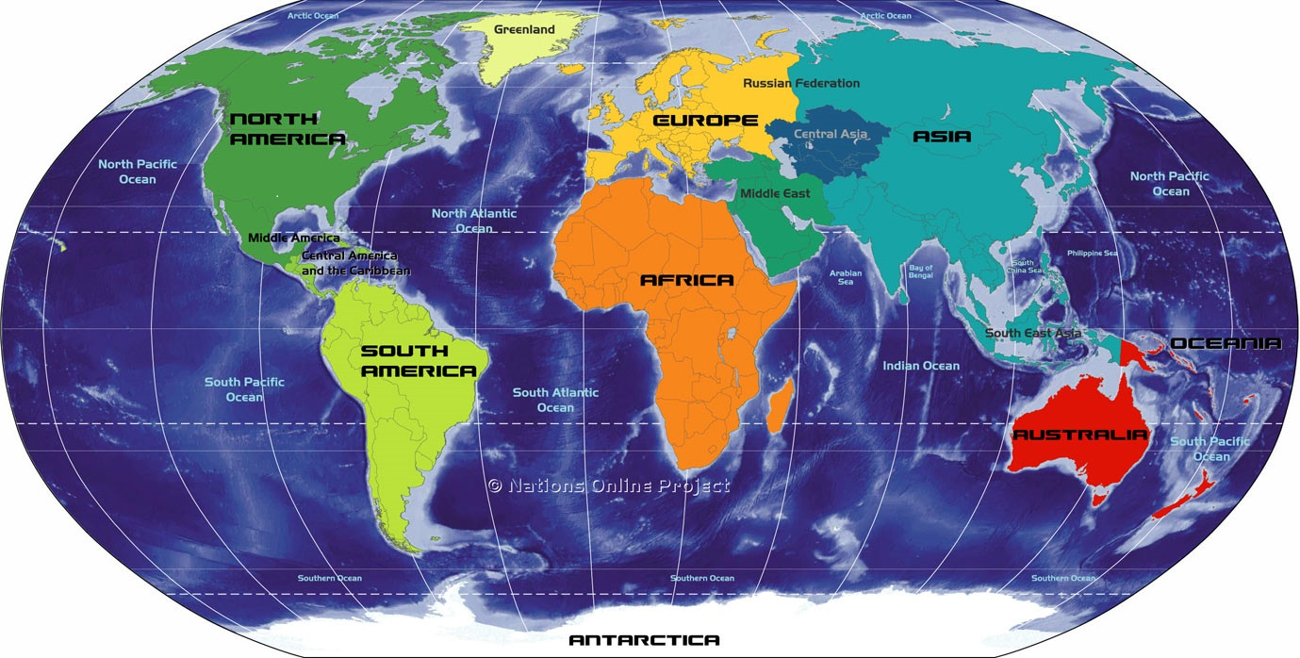
Mississippi
Doing Our Part to Eliminate Tuberculosis (TB)

Slide 2

What is TB Genotyping?
TB genotyping is a laboratory-based approach used to analyze the genetic material (e.g., DNA) of Mycobacterium tuberculosis, the bacterium that causes TB disease. The total genetic content is referred to as the genome. Specific sections of the M. tuberculosis genome form distinct genetic patterns that help distinguish different strains of M. tuberculosis. TB genotyping methods have changed over time with advances in laboratory technology.

Slide 3
Why do we use TB Genotyping?
Helps distinguish between persons whose TB disease is the result of TB infection that was acquired in the past, as compared to recently or newly acquired infection with development of TB disease,
Can add value to conventional contact investigations,
Offers a powerful tool to help direct the application of appropriate resources, since TB prevention and control efforts directed at preventing TB transmission are fundamentally different from efforts to prevent reactivation of latent TB infection, and
Allows us to monitor our progress toward eliminating TB transmission more accurately.

Slide 4
Familiar Strain
MTBC000842/G07925 in Mississippi

Slide 5
The Importance of the Contact Investigation (CI)
09/30/2020
07/08/2021
RVCT#2020MS202010030
RVCT#2020MS202010032
RVCT#2020MS202011035
RVCT#2020MS202012042
RVCT#2021MS202104007
RVCT#2021MS202105014
RVCT#2021MS202107019
RVCT#2021MS202107018

Slide 6
The CI Round-Up
2 of the cases were brother and sister
2 of the others were cousins to the brother and sister
1 of the cousins was a contact to a case in 2014, completed therapy for TBI while incarcerated and now has a cavitary chest x-ray
83 contacts were identified
22 were infected with TBI

Slide 7


Science & Leg Work Got Us Here
Genotyping
Contact Investigations

Slide 8
References
TB Genotyping | TB | CDC
https://www.cdc.gov/tb/programs/genotyping/default.htm

Slide 9

Tip: Always See What’s There
Do You See the Baby?

